Slide 1
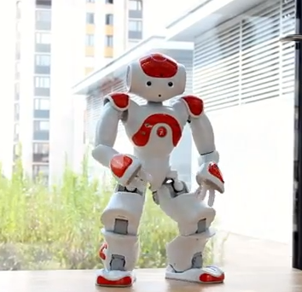
Ice skating with Naomi
Evolutionary Algorithms
Bas Bootsma, Roland Meertens
& Tom de Ruijter
2 October 2012

Slide 2
Goal
“Learning Naomi to ice skate in a simulated environment using HyperNEAT.”

Slide 3
Definitions
Ice skating:
Without ice skates;
In a straight line.
Stages in ice skating:
Initial stage (i.e. getting started);
Recurring stage (i.e. the actual ice skating movement).

Slide 4
Implementation
Simulator with a physics engine;
Initial speed (since focus on recurring stage);
Neuroevolution:
With HyperNEAT using indirect encoding.

Slide 5
Simulator
Gazebo:
Simulating the environment (match surfaces slipperiness with that of ice);
Simulating the robot (i.e. a stick model of the robot).
Should be easy to:
Run multiple trials;
Retrieve data from the simulator (i.e. position of the robot).

Slide 6
HyperNEAT
NEAT:
Increase complexity over time (keep track of genes);
Speciating the population (compete in niches at first);
Initially uniform population.
HyperNEAT (extension of NEAT):
Learn regularities (i.e. similarity or repeating patterns);
Input and output placement.

Slide 7
HyperNEAT
Mapping:
Initially only leg joints jaw and pitch (possibly extending with other joints, i.e. arms);
Time steps of 100 ms.
Fitness:
Maximalization within N seconds;
Falling over means minimal fitness;
Properties:
Distance;
Speed.

Slide 8
Previous work
Ice Skating Humanoid Robot
Chris Iverach-Brereton, Andrew Winton and Jacky Baltes (2012)
Evolving Robot Gaits in Hardware: the HyperNEAT Generative Encoding Vs. Parameter Optimization
Jason Yosinski, Jeff Clune, Diana Hidalgo, Sarah Nguyen, Juan Cristobal Zagal, and Hod Lipson (2011)
A Step Toward Evolving Biped Walking Behavior Through Indirect Encoding
Randal Olsen (2010)
Gait Evolution for Humanoid Robot in a Physically Simulated Environment
Nesrine Ouannes, NourEddine Djedi, Yves Duthen and Hervé Luga (2011)

Slide 9
Discussion

